Slide 1
CANDEV Data Challenge
Retention of Talents among Equity Groups

Slide 2
Contents
Correlations between retention and factors derived from survey
Address key drivers for the gap existing at the sub-group level

Slide 3
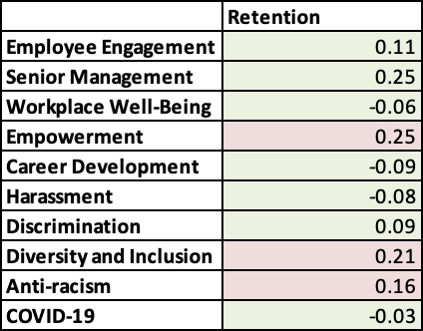
Correlation Between Retention Rate and NINE potential factors

Slide 4
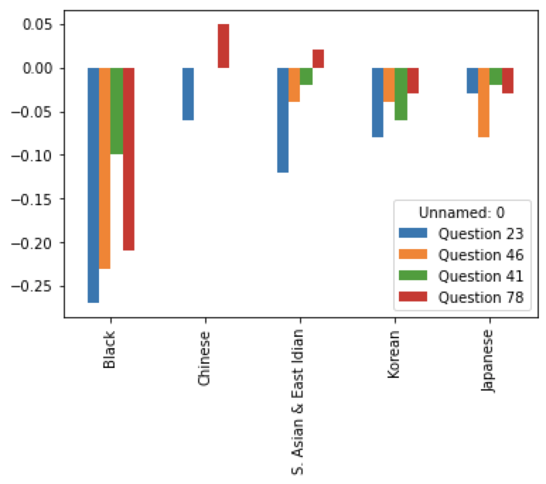
Address gaps at the sub-group level
Anti-Racism
Diversity and Inclusion
Career and Development
Workplace Well-Being

Slide 5
Reference
Creighton, S. B. (2017, December). Reducing risks from workplace discrimination - scholarworks. Retrieved February 6, 2022, from https://scholarworks.waldenu.edu/cgi/viewcontent.cgi?article=5535&context=dissertations&httpsredir=1&referer=

